Slide 1
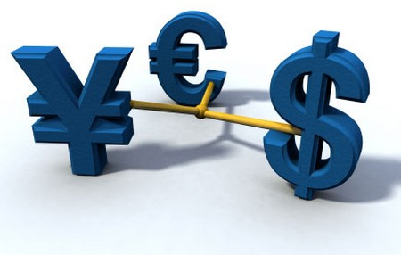
Unit 3: Exchange Rates
Foreign Exchange
3/21/2012

Slide 2
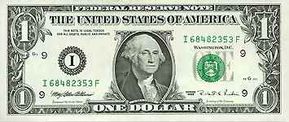
Exchange Rate
exchange rate –
price of one currency
in terms of another
For example:
dollars/euro ($/€) or
euros/dollar €/$)
It is important to specify
which is the denominator!

Slide 3
Exchange Rate
Unless otherwise specified,
our convention will be:
e ≡ exchange rate (in $/€)

Slide 4
Exchange Rate
spot transaction –
immediate (2 day)
exchange of bank deposits
spot exchange rate –
exchange rate for
spot transactions;
exchange rate for immediate
(2 day) exchange of bank deposits

Slide 5
Exchange Rate
forward transaction –
exchange of bank deposits
at some future date
forward exchange rate –
exchange rate for
forward transactions;
exchange rate for exchange of bank deposits at some future date

Slide 6
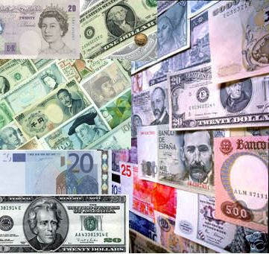
Exchange Rate
foreign exchange market –
the financial market where exchange rates are determined

Slide 7
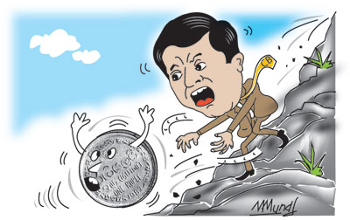
Exchange Rate
appreciation –
when a currency increases in
value relative to another currency
depreciation –
when a currency decreases in value relative to another currency

Slide 8
Exchange Rate
appreciation
country’s goods abroad become more expensive
foreign goods in the country become cheaper
(€/$)↑ means dollar appreciates
($/€)↓ means dollar appreciates
e↓ means dollar appreciates (e ≡ $/€)

Slide 9
Exchange Rate
depreciation
country’s goods abroad become cheaper
foreign goods in the country become more expensive
(€/$)↓ means dollar depreciates
($/€)↑ means dollar depreciates
e↑ means dollar depreciates (e ≡ $/€)

Slide 10
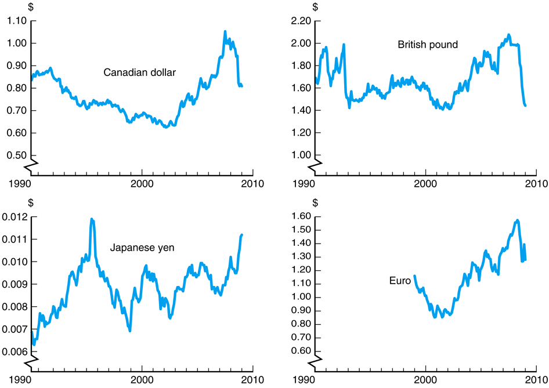
Exchange Rate

Slide 11
Purchasing Power Parity
law of one price (LOOP) –
the price of a good should be
the same throughout the world
(assuming transportation costs and trade barriers are low)
e.g., if steel costs $100/ton in America and €50/ton in Europe,
then the exchange rate should be
e = 2 $/€
There can be
only one!

Slide 12
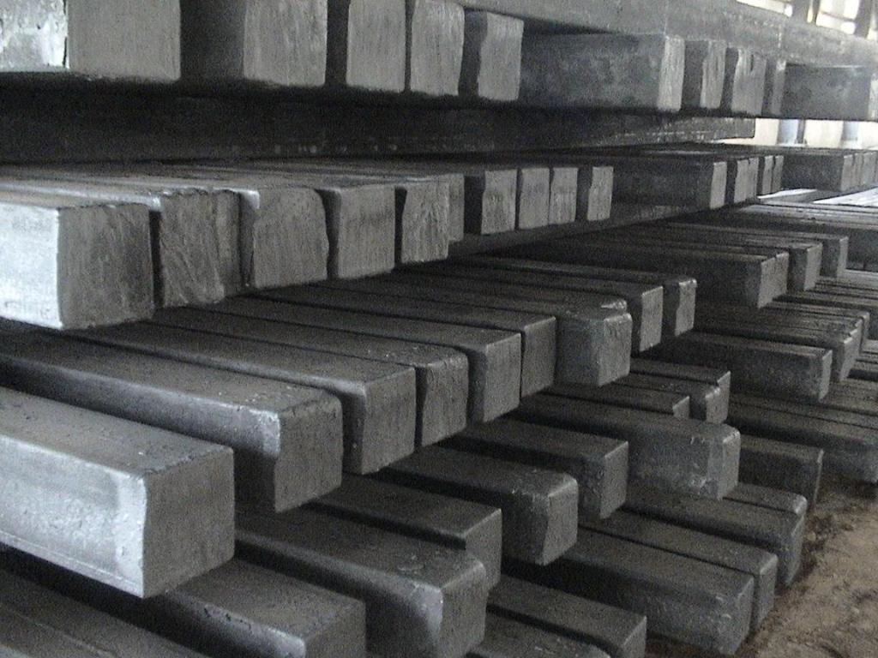
Purchasing Power Parity
arbitrage –
taking advantage of a price difference between two markets
Arbitrage causes the law of one price (LOOP). If prices are different, an entrepreneur can buy steel in the cheaper country and sell it in the more expensive country for a profit.

Slide 13
Purchasing Power Parity
theory of purchasing
power parity (PPP) –
exchange rates between any
two currencies will adjust to
reflect changes in the price
levels of the two countries
e.g., if the euro price level rises 10%, the dollar will appreciate 10%.
$
€

Slide 14
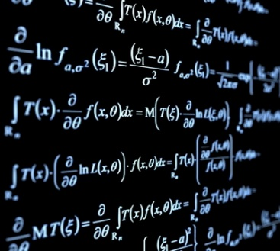
Purchasing Power Parity
PPP in math form
eP*/P = 1
e = P/P*
e ≡ exchange rate (in $/€)
P ≡ domestic price level (in $)
P* ≡ foreign price level (in €)
$
€

Slide 15
Purchasing Power Parity
PPP assumptions
all goods are identical
trade barriers are low
transportation costs are low
all goods traded across borders
all services traded across borders
These assumptions do not hold in the real world. PPP works in the long run, but not the short run.
$
€

Slide 16
Purchasing Power Parity

Slide 17
Improving LR Model over PPP
If we relax PPP assumptions that don’t hold empirically, the following equation isn’t 1:
eP*/P = 1
Instead:
eP*/P = q
q ≡ real exchange rate (in $/€)
$
€

Slide 18
Improving LR Model over PPP
nominal exchange rate (e) –
relative price of
two currencies
real exchange rate (q) –
relative price of
two output baskets
(prices of a country’s goods and services relative to another country’s goods and services)

Slide 19
Improving LR Model over PPP
By the assumptions of PPP, the relative price of output baskets in two countries will equal their relative price levels (adjusted to the same currency), so q = 1.
Introducing q makes the long
run model more robust.
$
€

Slide 20
Improving LR Model over PPP
improved long run in math form
eP*/P = q
e = qP/P*
e ≡ nominal exchange rate (in $/€)
q ≡ real exchange rate (in $/€)
P ≡ domestic price level (in $)
P* ≡ foreign price level (in €)
$
€

Slide 21
Long Run Exchange Rate
Long run determinates of e
relative price levels
trade barriers
imports vs. exports
productivity

Slide 22
Long Run Exchange Rate
Factor | Exchange Rate | Domestic Currency
domestic price level (P) ↑ | e↑ | depreciates
foreign price level (P*) ↑ | e↓ | appreciates
real exchange rate (q) ↑ | e↑ | depreciates
trade barriers ↑ | e↓ | appreciates
imports ↑ | e↑ | depreciates
exports ↑ | e↓ | appreciates
productivity ↑ | e↓ | appreciates

Slide 23
Long Run Exchange Rate
Factor | Exchange Rate | Domestic Currency
domestic M^{S} ↑ | e↑ | depreciates
foreign M^{S}* ↑ | e↓ | appreciates
domestic inflation (π) ↑ | e↑ | depreciates
foreign inflation (π*) ↑ | e↓ | appreciates
domestic output D ↑ | e↓ | appreciates
foreign output D* ↑ | e↑ | depreciates
domestic output S ↑ | E? | ambiguous
foreign output S* ↑ | E? | ambiguous

Slide 24
Interest Rate Parity
interest rate parity –
the rate of return should be the same throughout the world
(assuming capital mobility)
This is an arbitrage theory.
If there are capital controls imposed, interest rate parity
does not hold in the short run.
There can be
only one!

Slide 25
Interest Rate Parity
IRP in math form
RoR = (1 + i)
RoR* = [E(e_{t+1})/e_{t}](1 + i*)
RoR = RoR*
RoR ≡ domestic rate of return
RoR* ≡ foreign rate of return
i ≡ domestic interest rate
i* ≡ foreign interest rate
E(e_{t+1}) ≡ expected future spot rate
e_{t} ≡ spot exchange rate

Slide 26
Interest Rate Parity
RoR = (1 + i)
RoR* = [E(e_{t+1})/e_{t}](1 + i*)
RoR = RoR*
If you invest money domestically (at interest rate i), you should get the same return as investing money abroad (at interest rate i*) converting it initially at the spot rate and back at the expected future spot rate.

Slide 27
Interest Rate Parity
RoR = (1 + i)
RoR* = [E(e_{t+1})/e_{t}](1 + i*)
RoR = RoR*
e
RoR
e₁
RoR*
i₁
i %Δ

Slide 28
Interest Rate Parity
domestic interest rate rises → i↑ → shifts RoR right → e↓ → domestic currency appreciates
e
RoR₁
RoR₂
e₁
e₂
RoR*
i₁
i₂
i %Δ

Slide 29
Interest Rate Parity
foreign interest rate falls → i*↓ → shifts RoR* left → e↓ → domestic currency appreciates
e
RoR
e₁
RoR*₂
e₂
RoR*₁
i₁
i %Δ

Slide 30
Interest Rate Parity
expected future exchange rate falls → E(e_{t+1})↓ → shifts RoR* left → e↓ → domestic currency appreciates
e
RoR
e₁
RoR*₂
e₂
RoR*₁
i₁
i %Δ

Slide 31
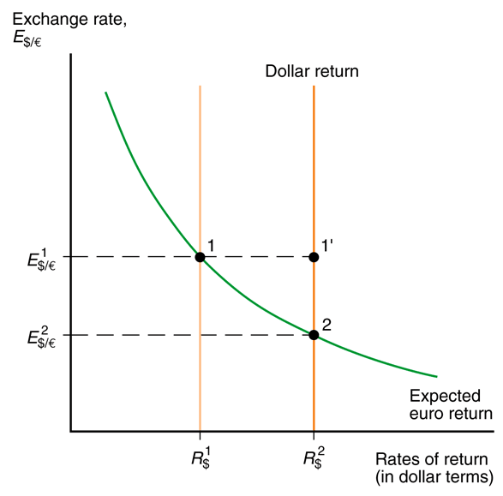
Interest Rate Parity
Fig. 14-5: Effect of a Rise in the Dollar Interest Rate
This is Krugman’s prettier graphics presentation of interest rate parity.
He uses E for the exchange rate instead of e and R for the interest rate instead of i.

Slide 32
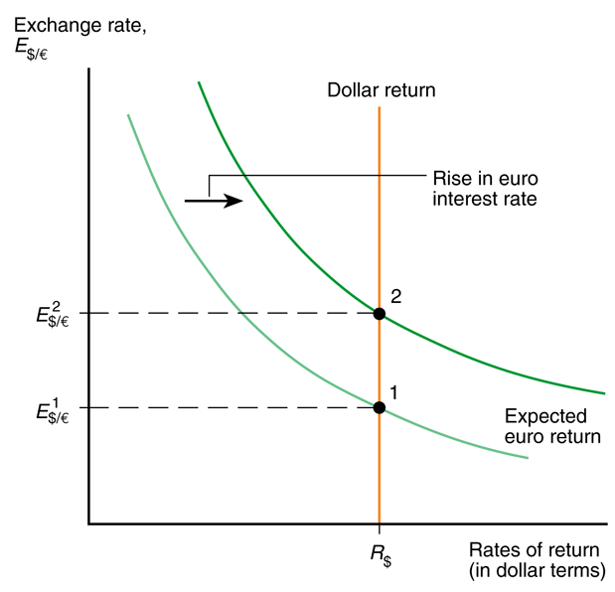
Interest Rate Parity
Fig. 14-6: Effect of a Rise in the Euro Interest Rate
More pretty graphics…

Slide 33
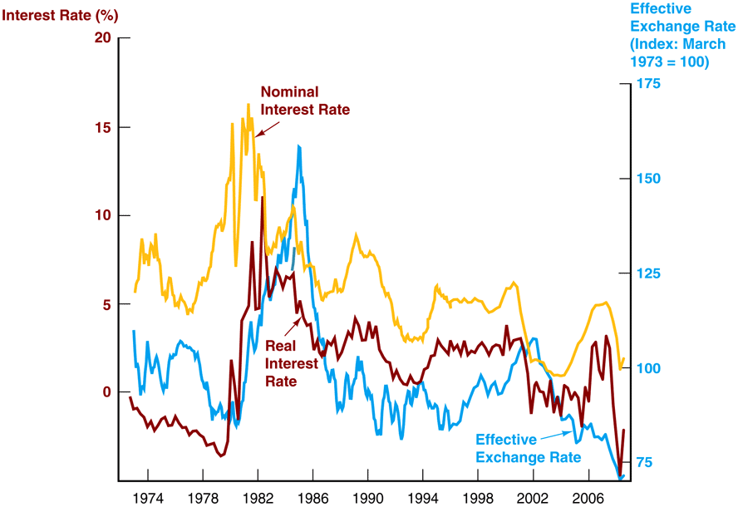
Interest Rate Parity

Slide 34
Short Run Exchange Rate
Factor | Exchange Rate | Domestic Currency
domestic interest (i) ↑ | e↓ | appreciates
foreign interest rate (i*) ↑ | e↑ | depreciates
expected future rate ↑ | e↑ | depreciates

Slide 35
Short Run Exchange Rate
Because the expected future spot exchange rate impacts interest rate parity, all of the factors that effect the long run exchange rate enter into those expectations and can affect the short run exchange rate.

Slide 36
Short Run Exchange Rate
Factor | Exchange Rate | Domestic Currency
expected domestic price level (P) ↑ | e↑ | depreciates
expected trade barriers ↑ | e↓ | appreciates
expected imports ↑ | e↑ | depreciates
expected exports ↑ | e↓ | appreciates
expected productivity ↑ | e↓ | appreciates

Slide 37
Interest Rate Parity + Money
Fig. 14-6: Effect of a Rise in the Euro Interest Rate
The money market can also affect the interest rate more directly than through the long run price level.
Recall the quantity theory of money and the graphical version of the liquidity preference theory.

Slide 38
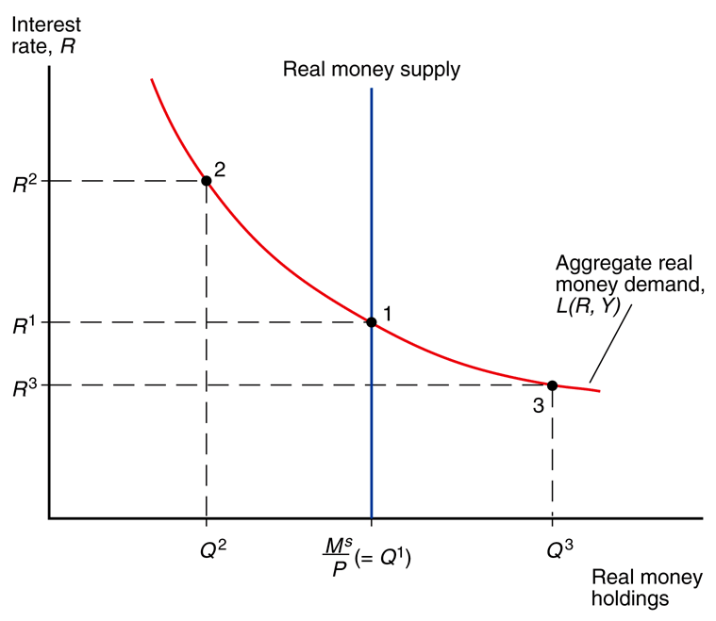
Interest Rate Parity + Money
Fig. 15-3: Determination of the Equilibrium Interest Rate
Krugman’s formulation is slightly different in that he has real money stock rather than nominal money on the x-axis, but it works the same.

Slide 39
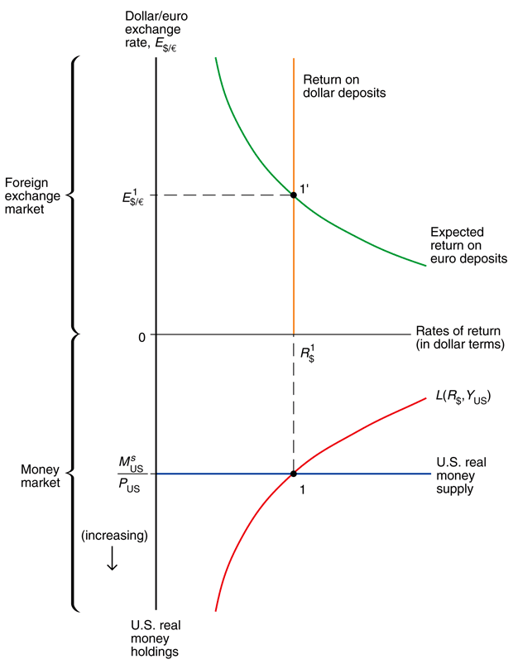
Interest Rate Parity + Money
The money market under the liquidity preference theory can be merged with the interest rate parity graph because they share the interest rate on one axis.

Slide 40
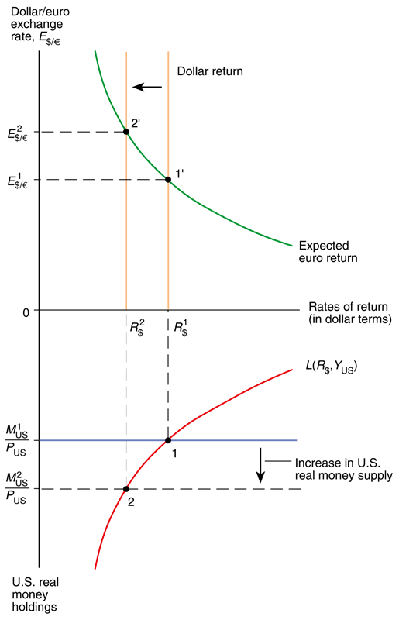
Interest Rate Parity + Money
With this graph it is easy to see how increasing or decreasing the real money stock affects the interest rate, and in turn affects the exchange rate through the interest rate parity condition.

Slide 41
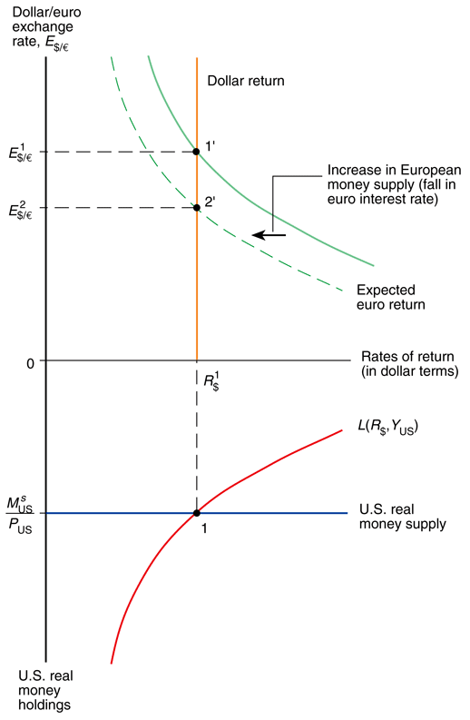
Interest Rate Parity + Money
In contrast if the foreign real money stock increases that doesn’t move the domestic money market at all, but will move the RoR* curve in the interest parity graph.

Slide 42
Short Run Exchange Rate
Factor | Exchange Rate | Domestic Currency
domestic M^{S}/P ↑ | e↑ | depreciates
foreign M^{S}*/P* ↑ | e↓ | appreciates

Slide 43
Overshooting
exchange rate overshooting –
short run exchange rate movements often overshoot their long run levels
For example a permanent one time increase in the US money supply will cause the dollar to depreciate immediately by a larger amount than its long run level, which will be a depreciation less than the short run.
Fig. 15-13: Time Paths of E
After a Permanent Increase
in U.S. Money Supply

Slide 44
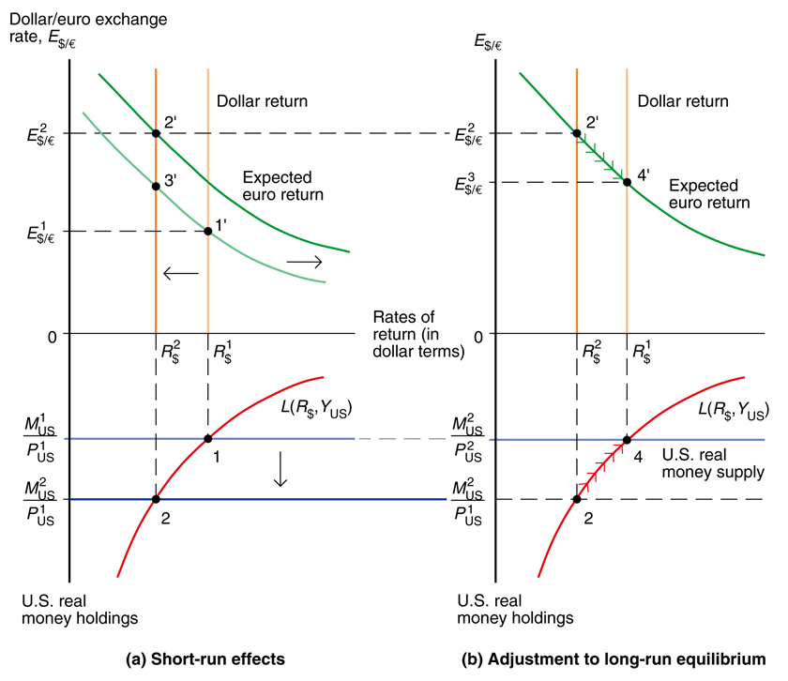
Overshooting
Fig. 15-12: Short-Run and Long-Run Effects of an Increase in the U.S. Money Supply (Given Real Output, Y)
Fig. 15-13: Time Paths of U.S. Economic Variables After a Permanent Increase in U.S. Money Supply

Slide 45
Overshooting
The thing to keep in mind both for long term vs. short term exchange rates and for overshooting is that the asset market is much faster
than the goods market.
Capital moves between countries near instantaneously, whereas trading goods requires a long and variable transportation lag time.
Fig. 15-13: Time Paths of E
After a Permanent Increase
in U.S. Money Supply

Slide 46
Short Run Exchange Rate
Krugman uses short run exchange rate fluctuations as an excuse to introduce Keynesianism.
We will talk about Keynesian theories (the Mundell-Fleming Model), but for our purposes interest rate parity drives the short run e and PPP drives the long run e.

